Slide 1

Disrupting the Status Quo for Identity
Mobile-Centric Human Identity
Biometrics First
Context Attributes
Dynamic Variables
Customizable
User Controlled
Can Augment or Replace Usernames & Passwords
1-Click User Experience

Slide 2
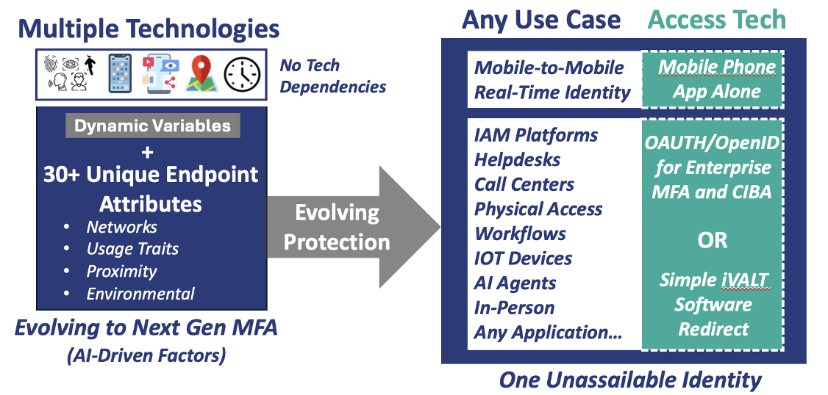
Future-Proof Approach

Slide 3
Same Strategy for AI Agent Identity
Identity + Context + Dynamic Variables
Example AI Agent Identity Factors:
Creator ID
Instance ID
Time of Creation
TOTP: new 2FA for AI agents
Expected Network Origin
Dynamic Variables (city hi/low temps X days ago or specific stock close Y days ago, many other variables and permutations)
All Data Access
All Communications
All Workflows
Unassailable AI Agent Identity

Slide 4

One Identity Platform for Everything !
Identity + Context + Dynamic Variables
Humans
FUTURE
IDENTITY NEEDS
AI Agents
Identity Validation Platform®
IOT Devices
iVALT is…. the Future of Identity
IOT Devices

Slide 5
